Slide 1
Big Data Management and Analysis in Physics Research
Marco Paganoni <marco.paganoni@unimib.it>
Andrea Biancini <andrea.biancini@unimib.it>

Slide 2
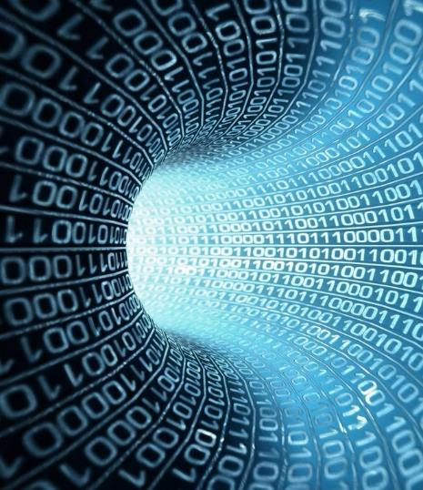

LET’S START BUILDING MODELS!
Today we will start creating models to analyze data and use them to obtain predicitons about future states and observations.
ML

Slide 3

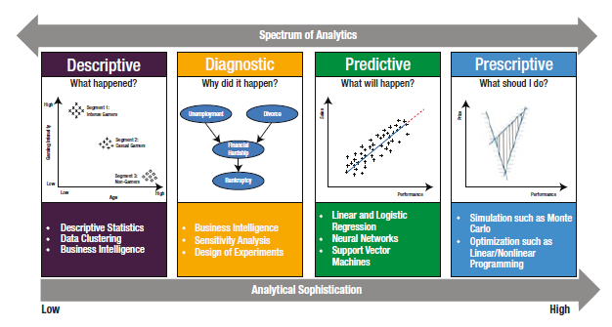
WHAT IS MACHINE LEARNING
Machine Learning is a method to analyse data and automate the construction of analytical models.
ML is a branch of IA and is based on the idea that systems can learn from data, identify autonomosly models to take decision with a reduced human intervention.

Slide 4


WHEN TO USE MACHINE LEARNING
Requirements
Scope
Very well defined question / business objective
Relevant data
Accurate data
Connected data
Large data (size do matters)
Too complex: when you can’t code it.
Too much: when you can’t scale it.
Too specialised: when you have to adapt and personalise.
Autonomous: when you can’t track it.

Slide 5

FIELDS OF APPLCATION
Recommenders
What my users like?
Classification
Who is going to buy my product?
Regression
How much is going to be the ROI?
Anomaly
Detection
Is everything ok?
4
3
0.4
2
error
1
0.2
0
0
-1
-0.2
-2
-0.4
error
-3
-0.6
-4
3
-0.5
-0.4
-0.3
-0.2
-0.1
0
0.1
0.2
-3
-2
-1
0
1
2

Slide 6
Supervised
Unsupervised
Reinforcement

Slide 7
SUPERVISED LEARNING
Supervised Learning
The most straightforward tasks fall under the umbrella of supervised learning.
In supervised learning, we have access to examples of correct input-output pairs that we can show to the machine during the training phase.
Supervised machine learning tasks can be broadly classified into two subgroups:
Regression is the problem of estimating or predicting a continuous quantity.
Classification deals with assigning observations into discrete categories.

Slide 8
UNSUPERVISED LEARNING
Unsupervised Learning
We have cases in which the output variable is unobservable, or infeasible to obtain.
Unsupervised learning tasks find patterns where we don’t have a set of “right answers” to learn from.
Unsupervised learning comprises different classes of problems, such as:
Clustering refers to grouping observations together considering similarities.
Generative models that can generate new data that resembles the training data in some sense.

Slide 9
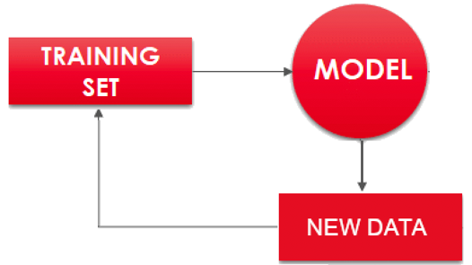
REINFORCEMENT LEARNING
Reinforcement Learning
In reinforcement learning, we do not provide the machine with examples of correct input-output pairs, but we do provide a method for the machine to quantify its performance in the form of a reward signal.
Reinforcement learning is used particularly in these cases:
Anomaly detection, algorithms that monitor some signal and indicates when something weird happens.

Slide 10
DEEP DIVE SOME TECHNIQUES
Main techniques presented:
Regression models
Classification models
Decision Trees
Clustering
MODELS

Slide 11
THANK YOU

